Slide 1
3D Computer Vision
Dr. Hassan Foroosh
School of EECS
UCF

Slide 2

Single view geometry
Camera model
Camera calibration
Single view geom.

Slide 3



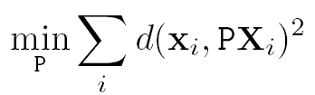

Gold Standard algorithm
Objective
Given n≥6 2D to 2D point correspondences {X_{i}↔x_{i}’}, determine the Maximum Likelyhood Estimation of P
Algorithm
Linear solution:
  Normalization:
  DLT
Minimization of geometric error: using the linear estimate as a starting point minimize the geometric error:
Denormalization:
~
~
~

Slide 4
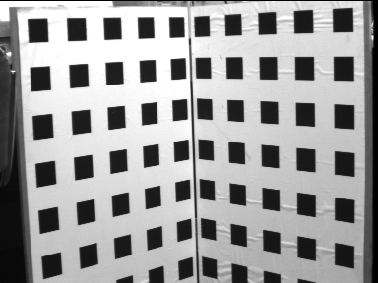



Slide 5
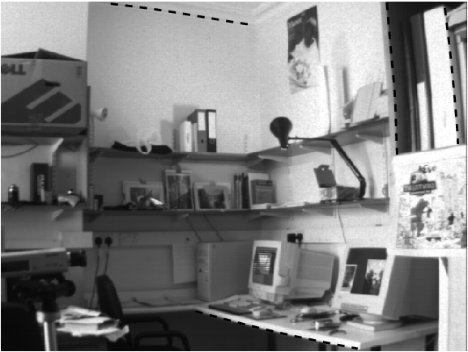
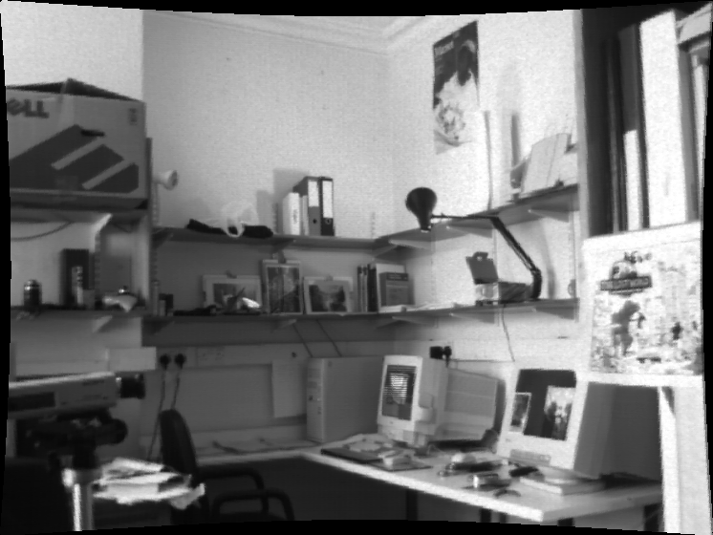


Slide 6
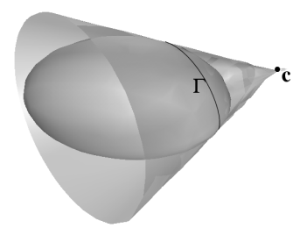



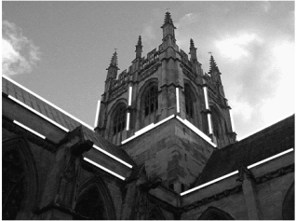

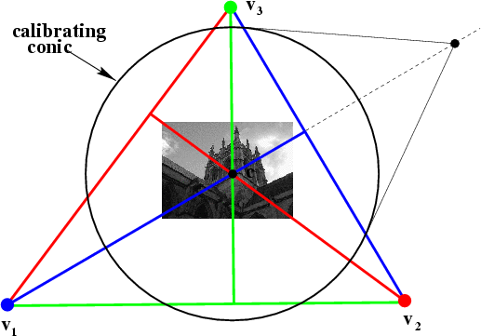
More Single-View Geometry
Projective cameras and
planes, lines, conics.
Camera calibration and vanishing points, calibrating conic and the IAC

Slide 7

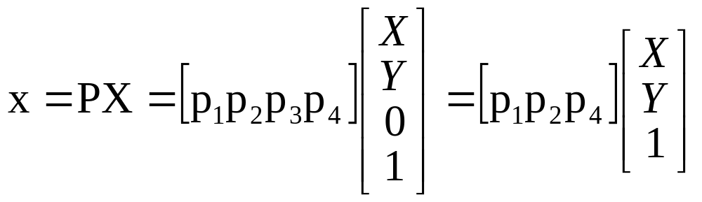
Action of projective camera on planes
The most general transformation that can occur between
a scene plane and an image plane under perspective
imaging is a plane projective transformation
(affine camera-affine transformation)

Slide 8

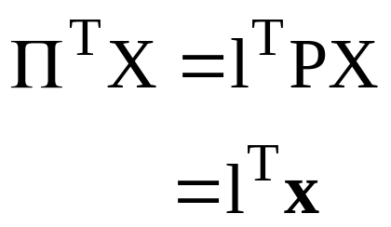
Action of projective camera on lines
forward projection
back-projection

Slide 9
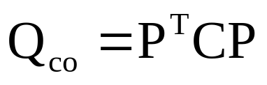
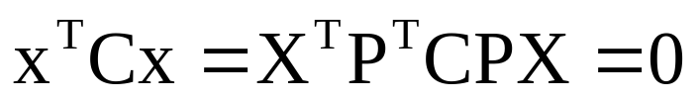


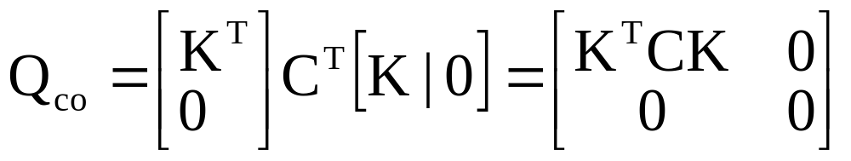
Action of projective camera on conics
back-projection to cone
example:

Slide 10
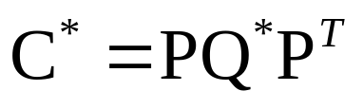
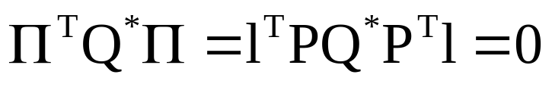

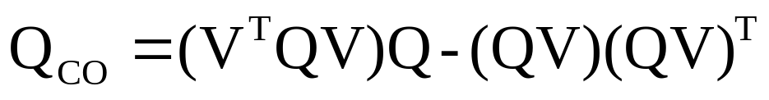
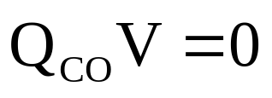
Action of projective camera on quadrics
back-projection to cone
The plane of Γ for a quadric Q in camera center C is given by Π=QC (follows from pole-polar relation)
The cone with vertex V and tangent to the quadric Q is

Slide 11
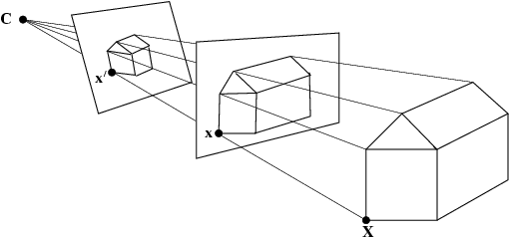
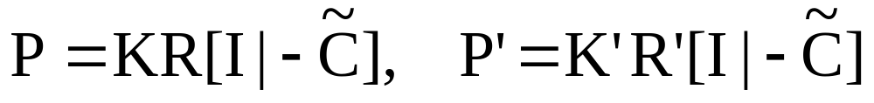
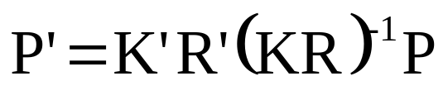
The importance of the camera center

Slide 12
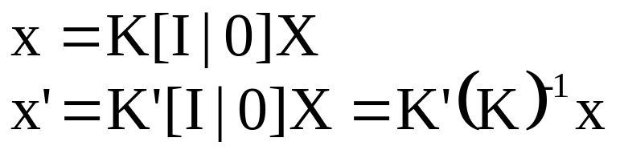
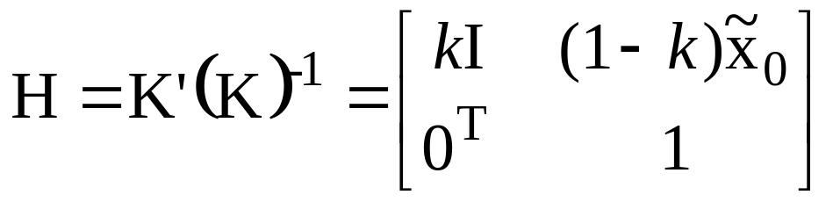
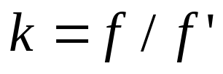
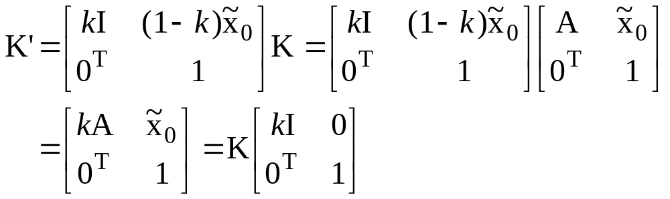
Moving the image plane (zooming)

Slide 13
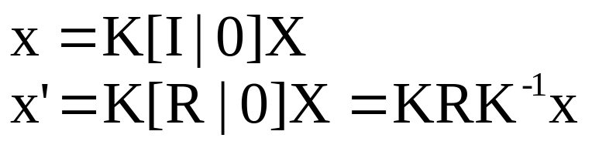

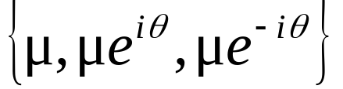
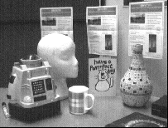
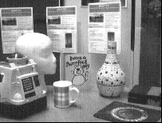

Camera rotation
conjugate rotation

Slide 14


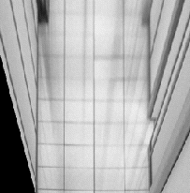
Synthetic view
Compute the homography that warps some a rectangle to the correct aspect ratio
warp the image

Slide 15
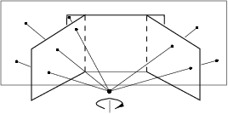

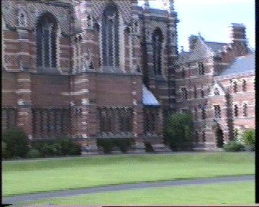

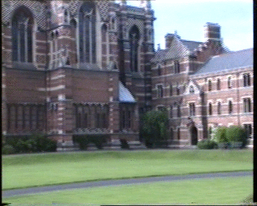


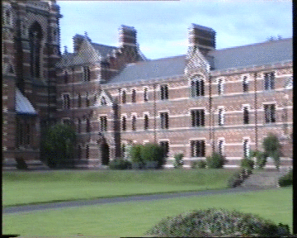
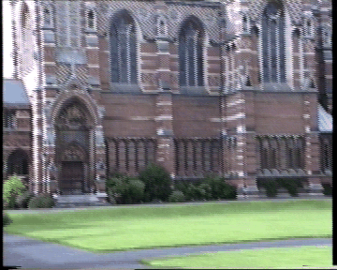

Planar homography mosaicing

Slide 16
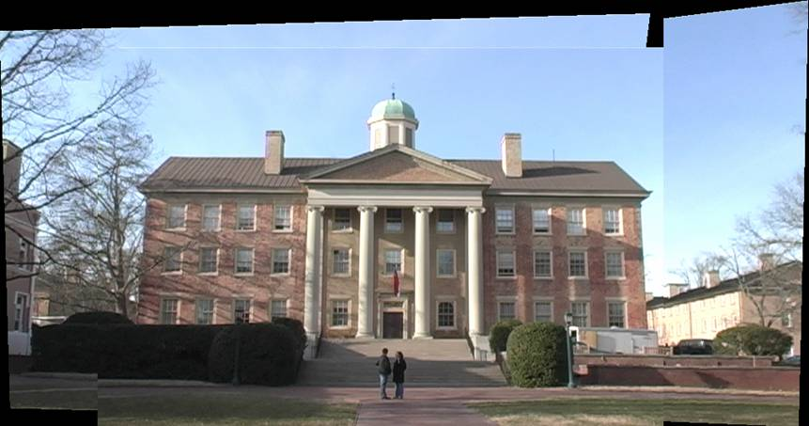
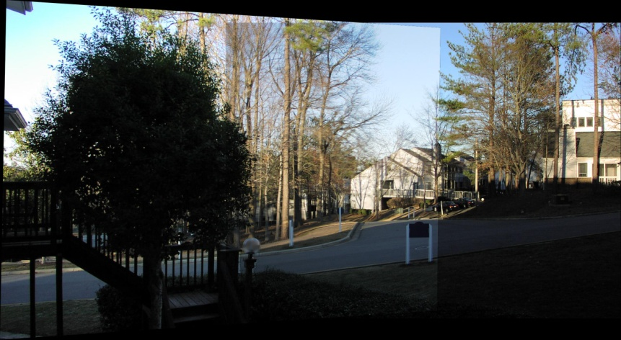
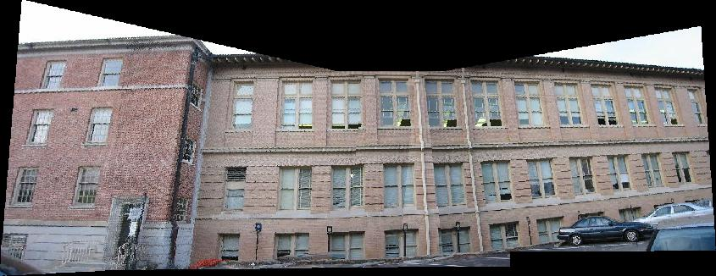
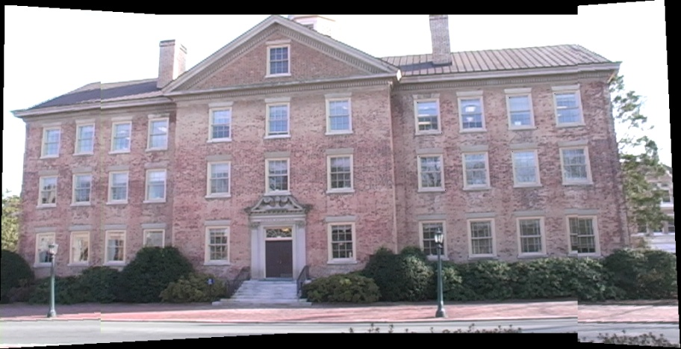
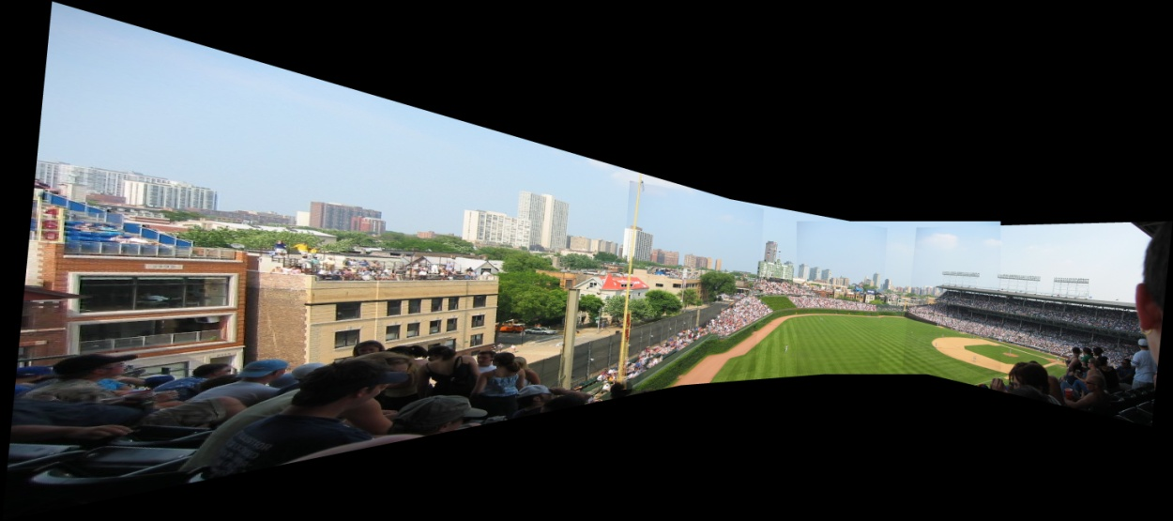
Planar homography mosaicing
more examples

